Slide 1


GOOGLE APPS
AN OVERVIEW OF GOOGLE APPS AND PROGRAM FEATURES
ICIT Technology Training and Advancement
Updated: 2021

Slide 2
Google Apps Overview
Google Drive
File storage (30 GB)
Google Docs (Word)
Spreadsheets (Excel)
Forms
Presentations (PowerPoint)
Drawings (Publisher)
Google Sites
Creating online webpages

Slide 3
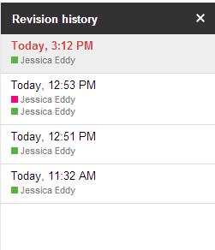

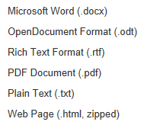
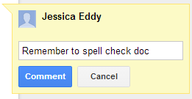
What Are The Features
Files are always in sync with all devices.
View revision history
Download Options (.doc,.xls)
Comments (threaded)
Notifications of changes
Auto-save
Collaborate with others in real-time

Slide 4
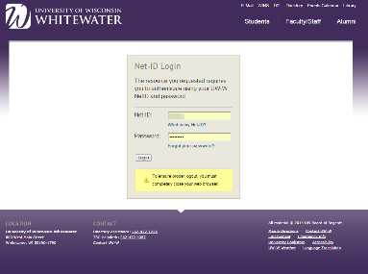
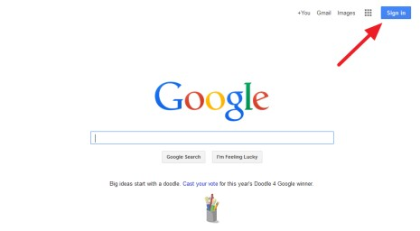
How to Access Google Drive
https://drive.google.com
Login using your Email address/Net-ID and
password

Slide 5
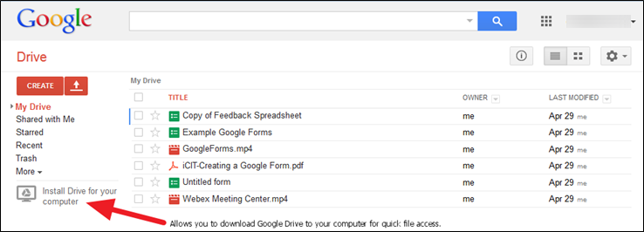
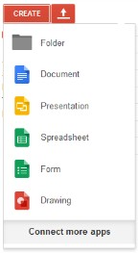
Google Drive Main Page
Clicking the Create button gives you access to:
Create new folders in Google Drive
Create a Google document or other Google app
Create a Google Form
Create a Google Drawing
Connect to other 3rd party apps

Slide 6

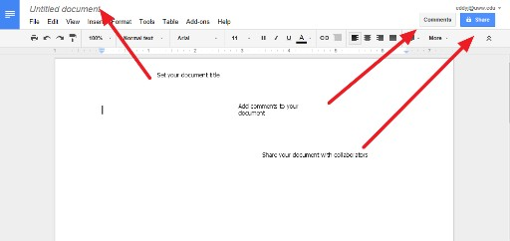
Google Docs
Change document title in upper left-hand corner
Use top toolbar to access document features
Use quick access toolbar to find frequently used tools
NOTE: all changes are saved automatically in Google drive. No need to save your document.
Share your document with other collaborators.
Collaborators can edit your document in real-time while you are editing your document. Changes will appear while you are working.
Simply close out of web browser tab when done editing your document.

Slide 7
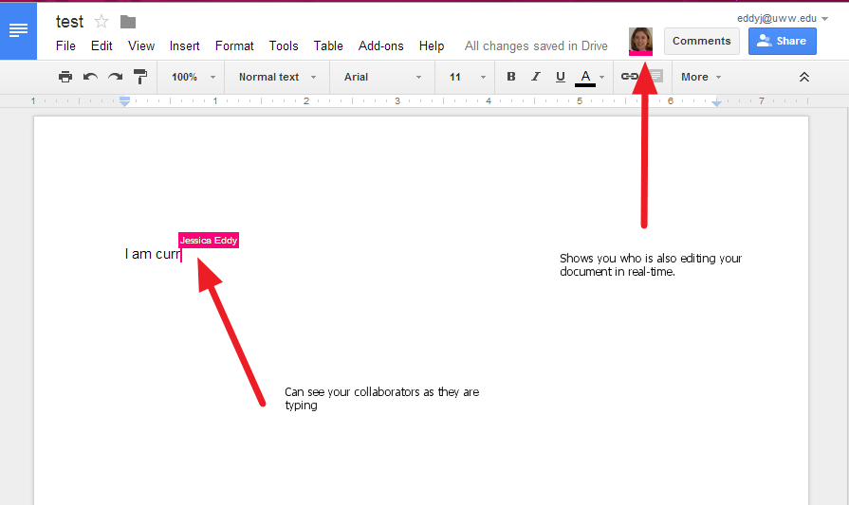
Collaborating With Others
See who is working on your file.
Watch users editing in real-time.
Collaboration works in all Google applications.
Max 50 collaborators at one time.

Slide 8
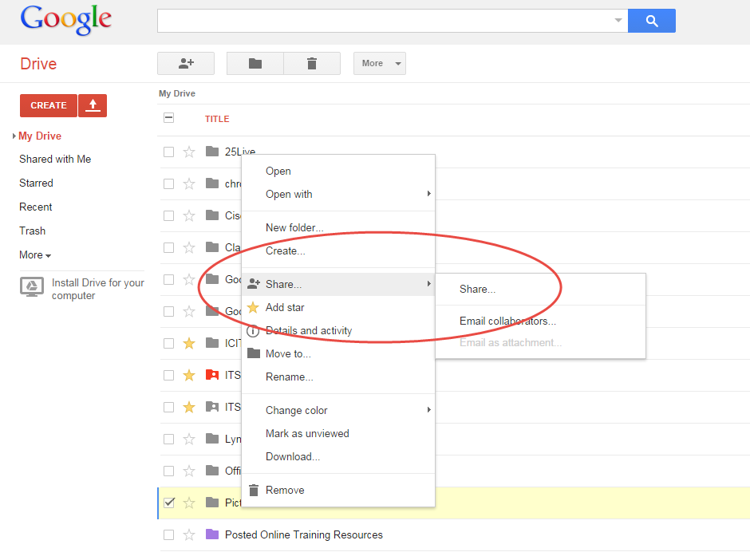
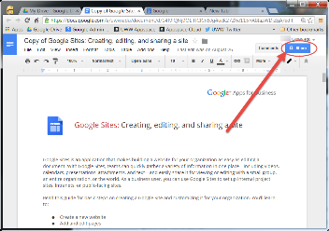
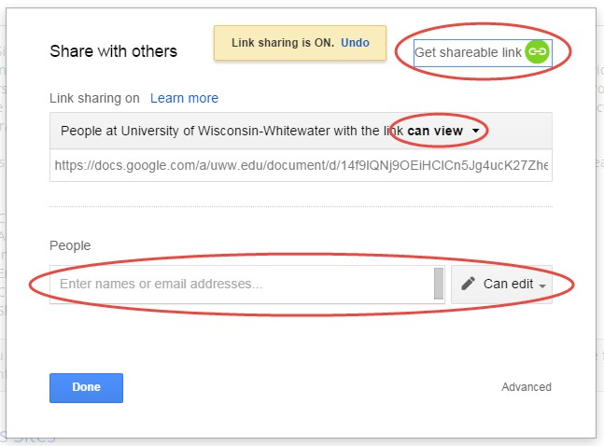
Sharing Google Files
Within Google Drive, right-click, then choose “Share”
Within a Google Doc, click the “Share” button

Slide 9

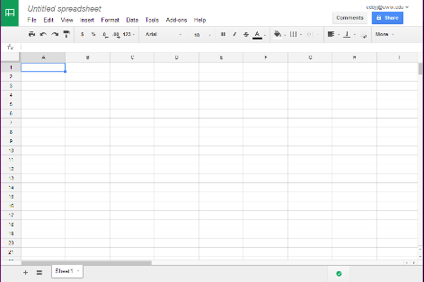
Google Spreadsheet
Similar to Microsoft Excel
Insert charts, images, videos
Create calculations and formulas
Create multiple sheets
Protect cells, sheets or the entire workbook
Configure notification rules notifying you of changes to your spreadsheet.

Slide 10

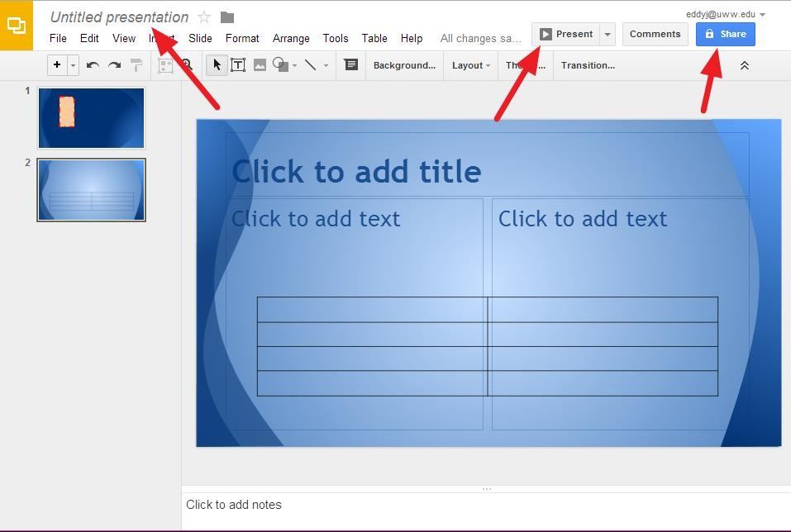
Creating a Google Presentation
Similar to Microsoft PowerPoint
Choose your title and theme
Top toolbar gives you access to more features
Quick-launch toolbar gives you quick access to commonly used features
Insert text, images, video, etc.
Insert tables
Presenter Views
click screen or scroll up/down to
advance
Full screen views
Presenter with speaker notes opens up additional notes window
Share your presentation with collaborators
Configure who can view your presentation

Slide 11
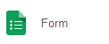
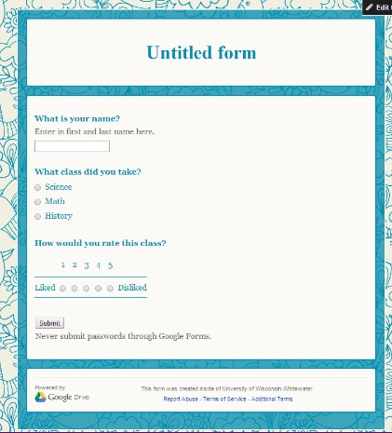
Google Forms
Create simple questionnaire type
forms
Questions types such as:
Text
Multiple choice
Dropdown boxes
Grids
Checkboxes
Select different theme backgrounds
Publish your form online
Save form results to Google Spreadsheets
Set notification rules to notify you of changes

Slide 12

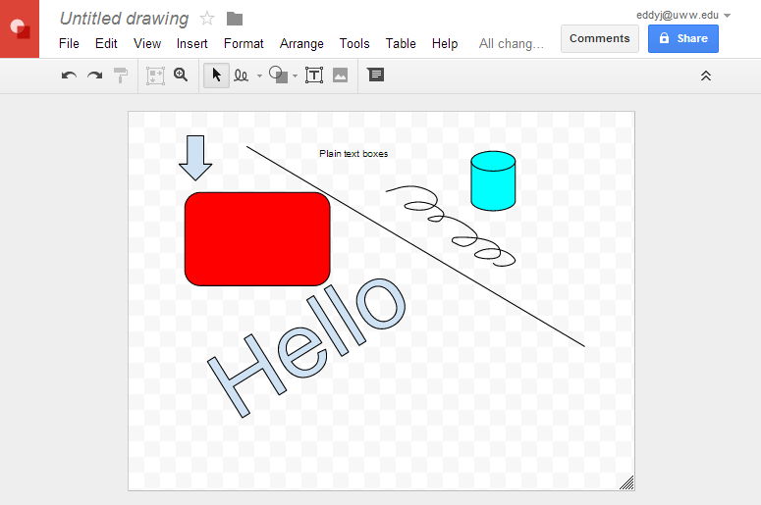
Google Drawing
Picture editing tool similar to Microsoft Publisher
Create different kinds of boxes, arrows, lines, scribbles, etc
Change font colors or fill in shapes with different colors
Insert pictures and even take a snapshot using your computer camera
Other fun tools

Slide 13
Google Sites
https://sites.google.com – login with email address/Net-ID and password.
Easily create websites to share with others
Create announcement boards
Post documents and link to other websites
Embed YouTube videos
Embed Google docs, forms, etc
Click on publish when done
Give it a name when prompted. This will be your site link

Slide 14



HELPFUL RESOURCES:
Google Apps for Education Help Pages:
http://www.google.com/enterprise/apps/education/products.html
http://learn.googleapps.com/
https://support.google.com/
Lynda.com: http://go.uww.edu/lynda
ICIT Training Website: http://www.uww.edu/icit/services/google

Slide 15
THANKS!
Any questions or comments?
Thank you for your time!

Slide 16
WRAPPING UP CMP103
MCQ QUESTIONS, 20 MINUTES
MATRIC NUMBER AND ELIGIBILITY CARD TO LOG IN
EXAM FOCUS:
COMPUTER APPRECIATION
SOFTWARE
HARDWARE
ACRONYMS
INTRODUCTION TO NETWORKS
AI
CLOUD COMPUTING
PHISHING
CYBER-SECURITY
USE OF MS OFFICE
USE OF GOOGLE APPS
VIRUS AND SECURITY

Slide 17
WILL IT BE DIFFICULT?
NO!
JUST ENSURE YOU READ AND UNDERSTAND THE MODULES.
SUBMIT YOUR EXAMS AND SIGN OUT
THE EXAM WILL BE ON THE BHU LMS

Slide 18
ASSESSMENT
20 MARKS – PRESENTATION
10 MARKS – PRACTICALS
10 MARKS – GOOGLE APPS

Slide 19
FINAL C.A (10 marks)
Using Google Sites, create a simple page site to sell a product. Save the page to flash drive.
Using Google Form create a simple form that will ask the following questions:
Name
Matric Num
Department
Your state of Origin
When done with the form, fill it yourself and save the page to your flash drive. Send to ICT for PRINTING

Slide 20
And the last slide…
ITE PROFESSIONAL CERTIFICATION
TO HOLD 2ND SEMESTER UPON RESUMPTION
WILL BE YOUR 1ST INTERNATIONAL PROFESSIONAL CERTIFICATION.
EXAM WILL BE ONLINE.
FACILITATED BY CISCO.
REGISTRATION FEE IS N10,000
GOOD-LUCK IN YOUR EXAMS

